Slide 1
Simple parity checking
Original data
1 1 0 0 1 1 1
1
0 1 1 1 0 0 1
0
Odd Parity
Even Parity

Slide 2
Two dimensional parity checking
Original data
1100111 1011101 0111001 0101001
1 1 0 0 1 1 1
1
Row parities
1 0 1 1 1 0 1
1
0 1 1 1 0 0 1
0
0 1 0 1 0 0 1
1
0 1 0 1 0 1 0
1
Column parities
11001111 10111011 01110010 01010011 01010101
Data and parity bits

Slide 3
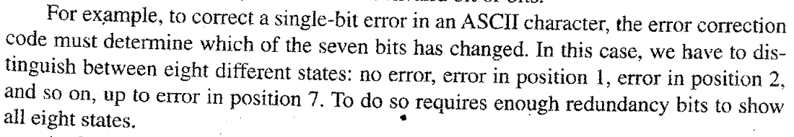
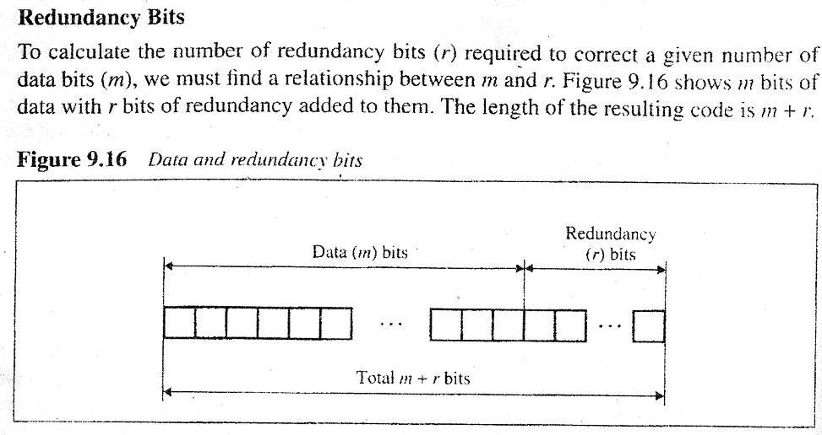
Hamming Code to Correct Single Bit Errors

Slide 4
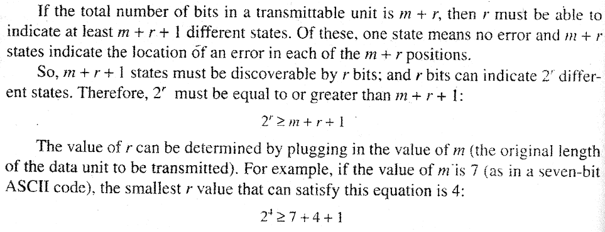
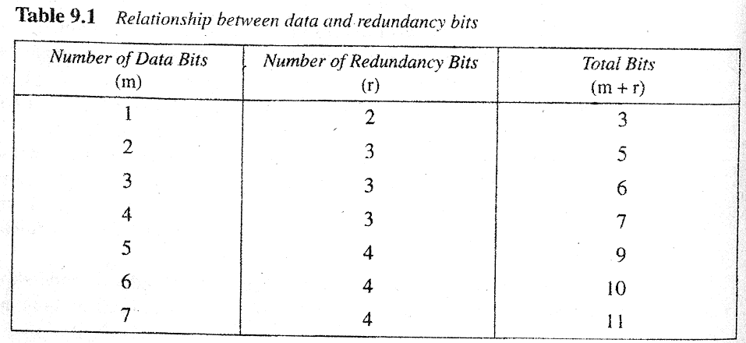
Hamming Code to Correct Single Bit Errors

Slide 5
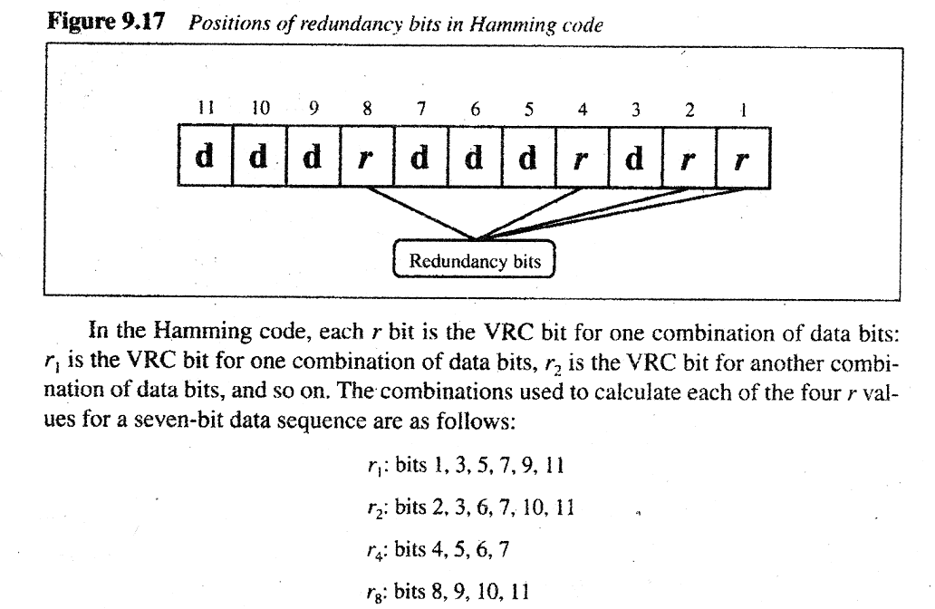
Hamming Code to Correct Single Bit Errors

Slide 6
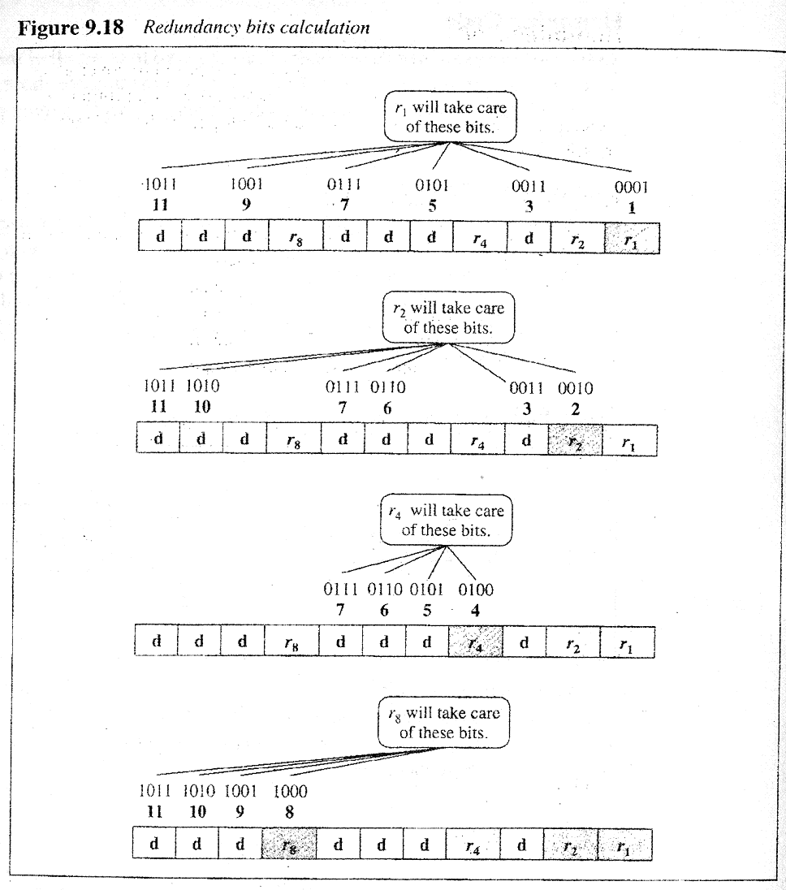
Hamming Code to Correct Single Bit Errors

Slide 7
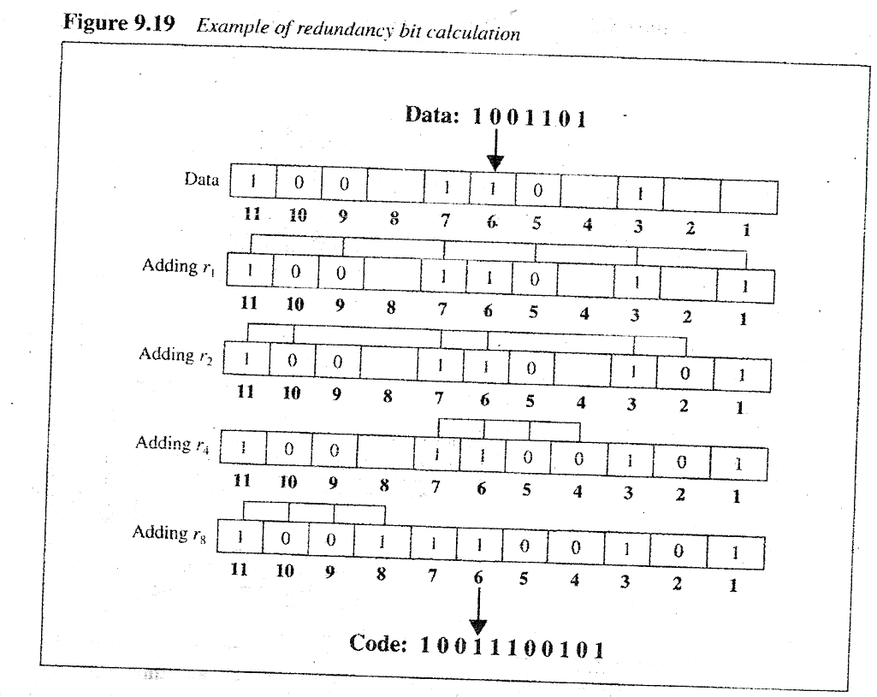
Hamming Code to Correct Single Bit Errors

Slide 8
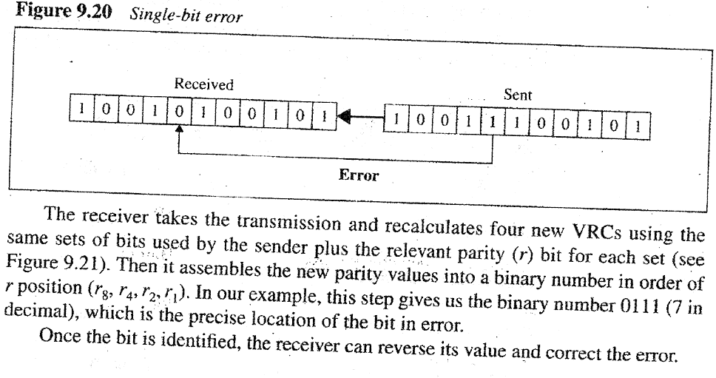
Hamming Code to Correct Single Bit Errors

Slide 9
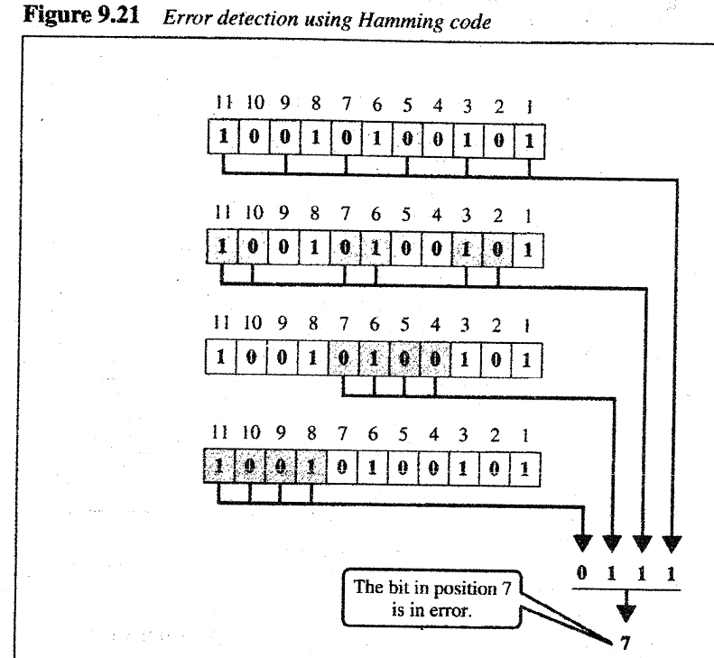
Hamming Code to Correct Single Bit Errors

